Slide 1

Introduction to remote sensing
VET course
SADL – Evert Van Bever
KU Leuven

Slide 2
Table of content
Remote sensing
The electromagnetic spectrum
Visualisation of collected data
Spectral signature
Image properties
LiDAR
Satellite data sources

Slide 3
Learning objectives
At the end of the course the participants should be able to:
Explain what remote sensing is
Explain the difference between EO & RS
Describe and discuss different types of resolution
Explain the electromagnetic spectrum in the context of RS
Identify the main features of satellites that determine their capabilities
Explain what LiDAR is and how it works
Explain uses of LiDAR

Slide 4
Remote sensing
1
Notes:
First of all, it must be determined what remote sensing is.

Slide 5
Earth observation
Earth observation refers to the collection of information about the Earth’s physical, chemical, and biological systems through various means:
Satellite imaging
Areal photography
Ground-based measurements
…
Notes:
An important term often talked about is earth observation(s). But what is it exactly: it is collecting information about the earth (psychically, chemical and biologically).
This is done thru multiple ways: with satellites, areal pictures, ground-based measures etc.
Source:
How are Earth Observation and Remote Sensing Different? | New Space Economy
Earth observation: How does it work? (youtube.com)

Slide 6
What is remote sensing?
Remote sensing is the collection of information about an object or phenomenon without making physical contact with the object.
The sensors must be in some distance from the object.
In our case the object an area of the Earth surface and the sensor is measuring electromagnetic radiation leaving the Earth from a satellite platform.
Specifically: the use of satellites to gather information about the Earth’s surface and atmosphere
All remote sensing is a form of earth observation, not all earth observation is remote sensing.
Notes:
Then what is remote sensing, well it is when this data is collected from a remote place, this not thru directly making physical contact.
This sensors are used to collect this info from a distance. For this context is thus collecting electromagnetic radiation from the earth in a satellite.
A satellite does this for the earth’s surface and the atmosphere that also is in the collection range.

Slide 7
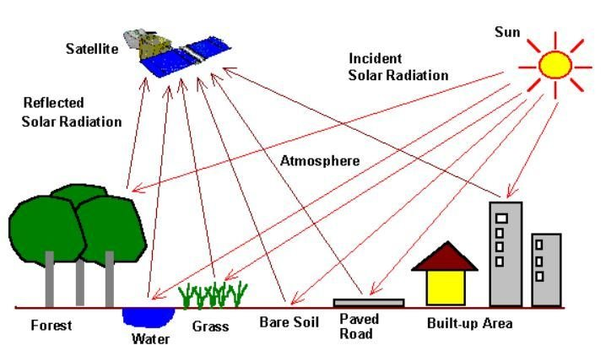
What data does a satellite collect?
The remote sensor samples emitted, reflected or scattered electromagnetic radiation (EMR).
Notes:
A satellite thus collect information, but what?
It collects all electromagnetic radiation that is emitted, reflected or scattered.

Slide 8


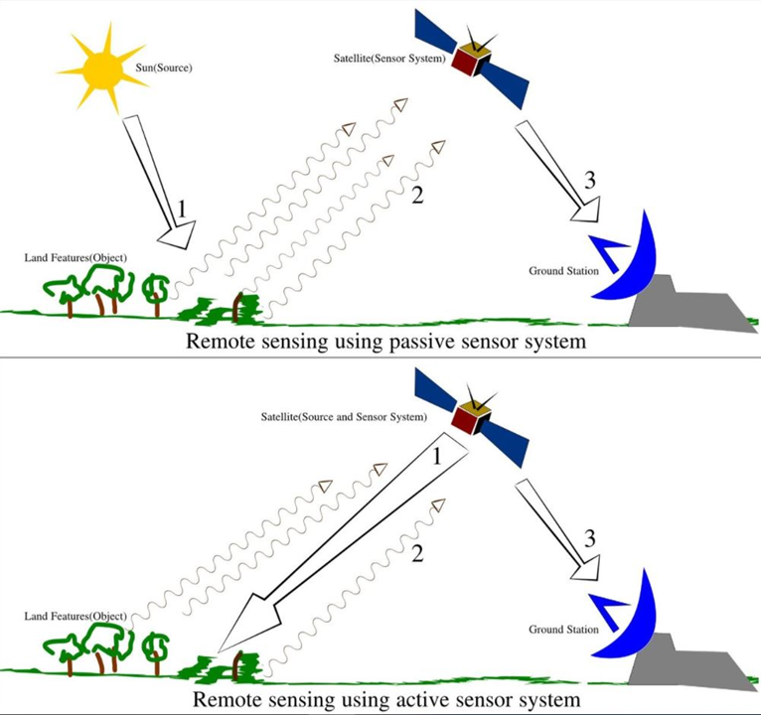
Types of sensors
Passive Sensor: detects natural energy (radiation) that is emitted or reflected by the object.
Reflected sunlight is the primary source of radiation measured by passive sensors
Active Sensor: generates energy in order to scan objects and areas. The sensor measures the amount of energy returned from the target
e.g. synthetic-aperture radar (SAR).
Notes:
The radiation can come from multiple sources and have different types of sensors in satellites.
The passive satellite uses radiation that is already there, often from the sun (reflected) or send out by the earth itself.
One can compare it to our eyes observing our surrounding.
On the other hand, there is also the active sensors: these send out some energy first and measure the amount reflected. An example is a radar.
We can compare this to how bats observe their surroundings. They also use the sonar reflection they send out.

Slide 9
The electromagnetic spectrum
2
Notes:
One important concept from physics/ optics to go over is the electromagnetic spectrum, as it is key in passive RS satellites.

Slide 10
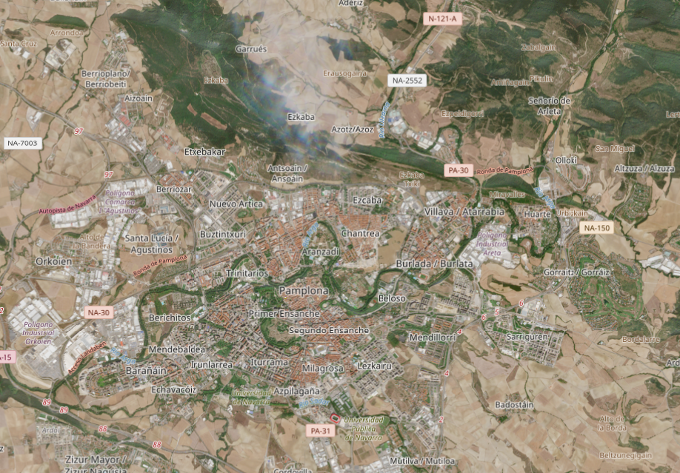
Notes:
This is an image from a satellite that seems very familiar to all of us. It shows the true colors of the city. How does this come?
Copernicus. (n.d.). Copernicus Browser [Image]. European Union, Copernicus Data Space Ecosystem. https://browser.dataspace.copernicus.eu/

Slide 11
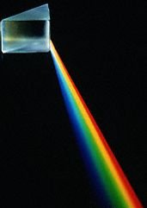
The electromagnetic spectrum
The visible part
Notes:
The electromagnetic spectrum is easily explained starting from this image. A prism splitting light in its different wavelengths as colors.
E.g. dark side of the moon by pink floyd

Slide 12
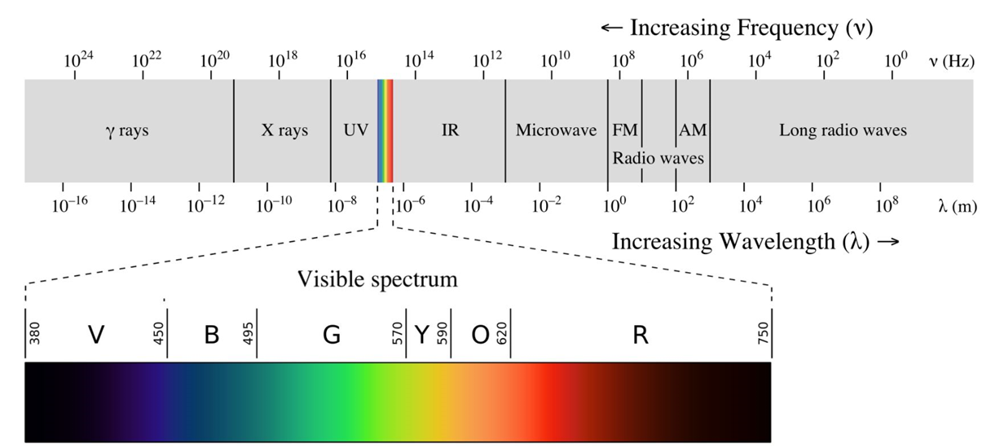
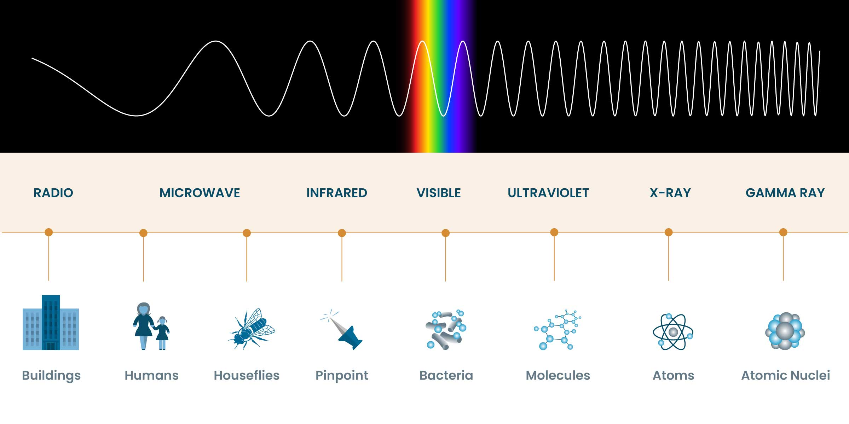
The electromagnetic spectrum
Electromagnetic radiation is classified by wavelength into gamma rays, X-rays, ultraviolet, visible, infrared, microwave and radio.
Optimus Medica, n.d.
Notes:
We know the visible spectrum of the EM spectrum the best. Here you can see it with the different wave lengths.
However there are more EM waves in the spectrum then the visible one. The whole spectrum is also split into groups.
Optimus Medica. (n.d.). Electromagnetic spectrum [Image]. Optimus Medica. https://www.optimusmedica.com/definition/electromagnetic-spectrum/

Slide 13
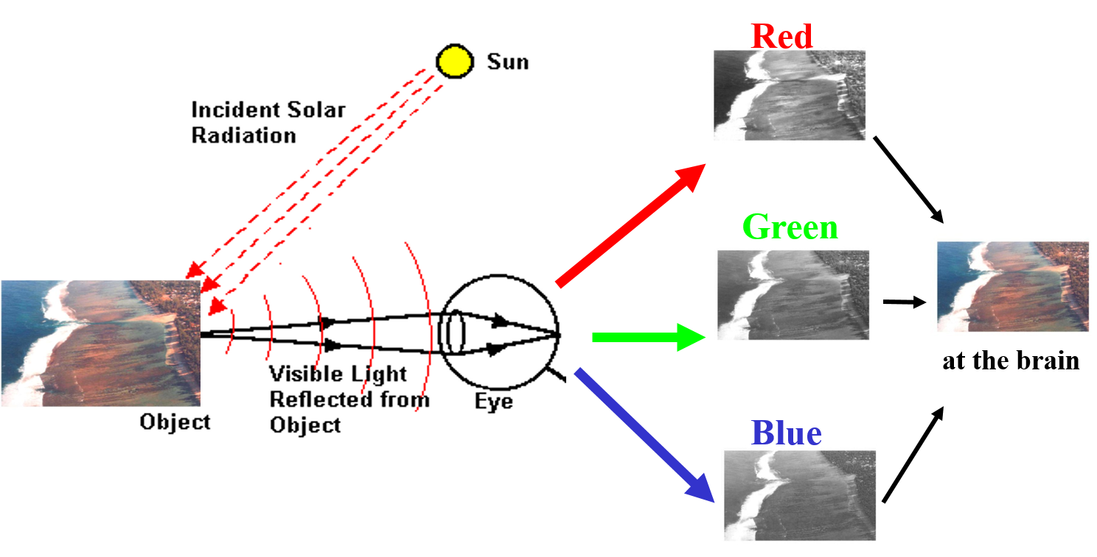
Analogy with out eyes
Notes:
To show how a satellite observes these EM waves an analogy can be made with how our eyes work.
The suns falls in on our surroundings;
The reflected light (by the object) is detected by our eye
Our eye splits this reflection (using receptors) into the 3 primary colours and shows the amount of refection of each color
Our brain combines this into one image and we see the colors of objects/ our surroundings

Slide 14
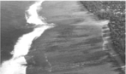
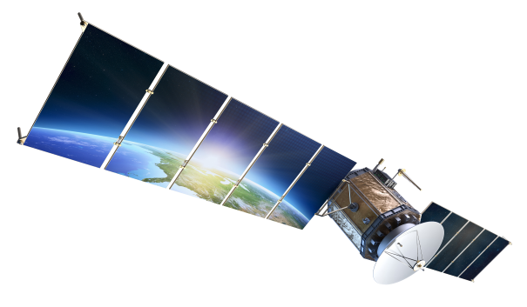
Satellite
e.g. NIR
Notes:
In a satellite it works very similarly. But there are some key differences:
It’s not an eye, but a satellite
A satellite does not only detect visible light, also the non-visual
The satellite does not only split & detect the primary colors, but also invisible waves e.g. near infrared (NIR)

Slide 15
Visualisation of collected data
3
Notes:
Okay now it is clear how a satellite collects the data, but visualizing is another story.

Slide 16
Satellite
e.g. NIR
BANDS
Notes:
Here one can see the image we looked at before.
The number of split EM-waves can be seen here as 4.
In the sector we often call this the amount of detected bands.

Slide 17
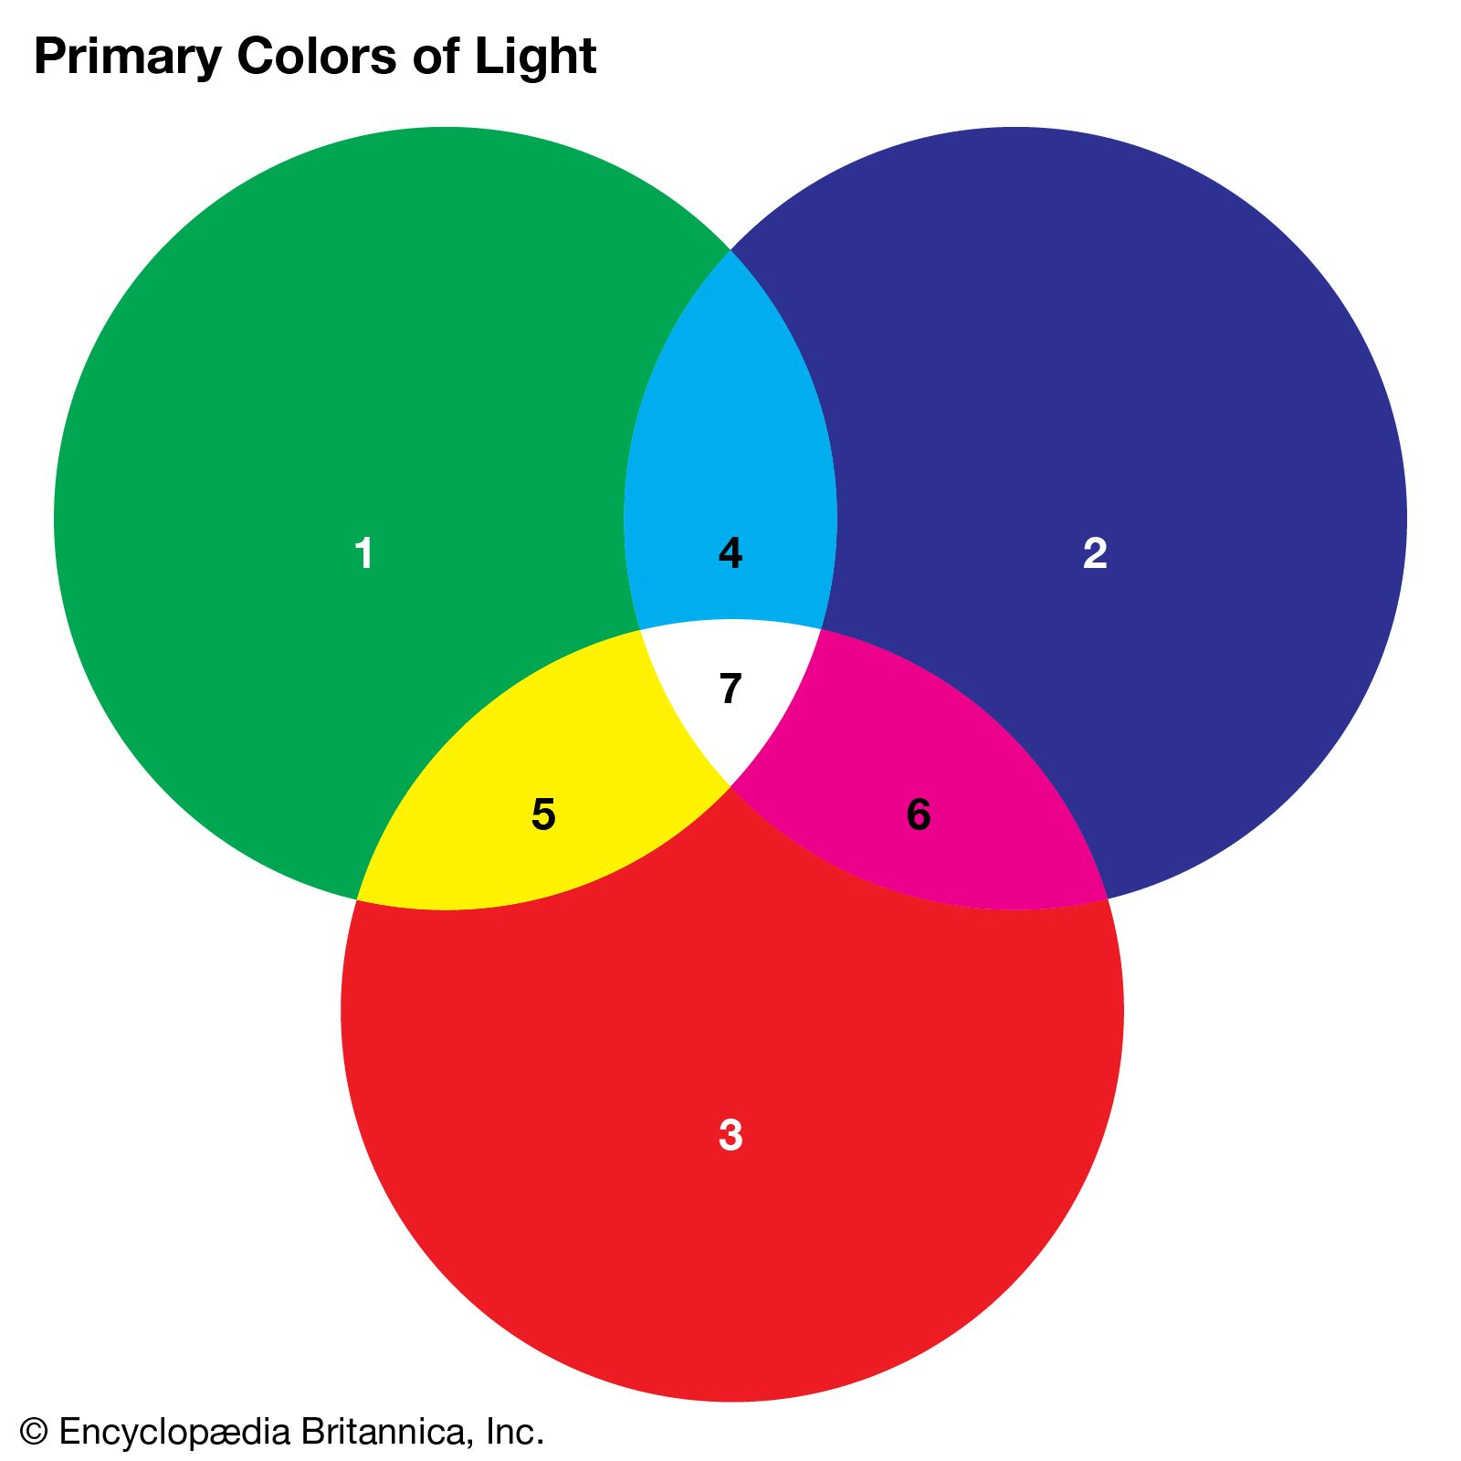
Primary colours: RGB
%
%
%
Notes:
From a RGB perspective it is clear that we can show the amount of detected light from the red band as red, green as saturated green and blue as saturated blue.
This combines in an image as we perceive it. This is what we call a true color composite.
Encyclopaedia Britannica. (n.d.). Primary color. In Britannica. Retrieved [today’s date in Month Day, Year format], from https://www.britannica.com/science/primary-color

Slide 18
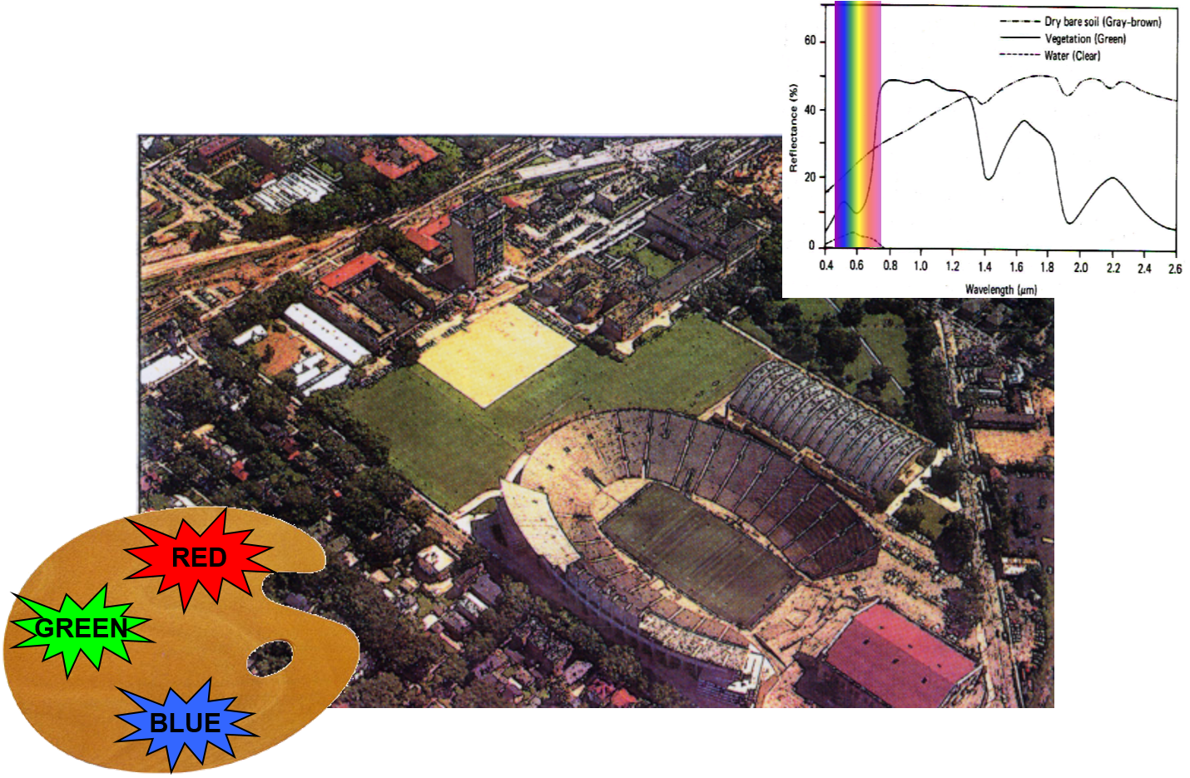
True colours: true colour composite
Notes:
This is true color composite, the amount of red wavelength detected put in the red color, the green in the green color, and blue in blue.

Slide 19
Representing other bands
Optimus Medica, n.d.
Notes:
Until here it was very clear on what to do, as it is true to our perception.
However, we have only considered the reflected wavelengths in the visible light.
Once we also consider other wavelengths, e.g. NIR we have a problem. There is still only the 3 primary colors available.
This means we have to make choices if we want to display (and thus analyze) the amount of infrared light detected.
The amount reflected from a true color must be let go of. And a primary color is shifted to the amount of IR.
The image that is then created is referred to as a false color composite.

Slide 20
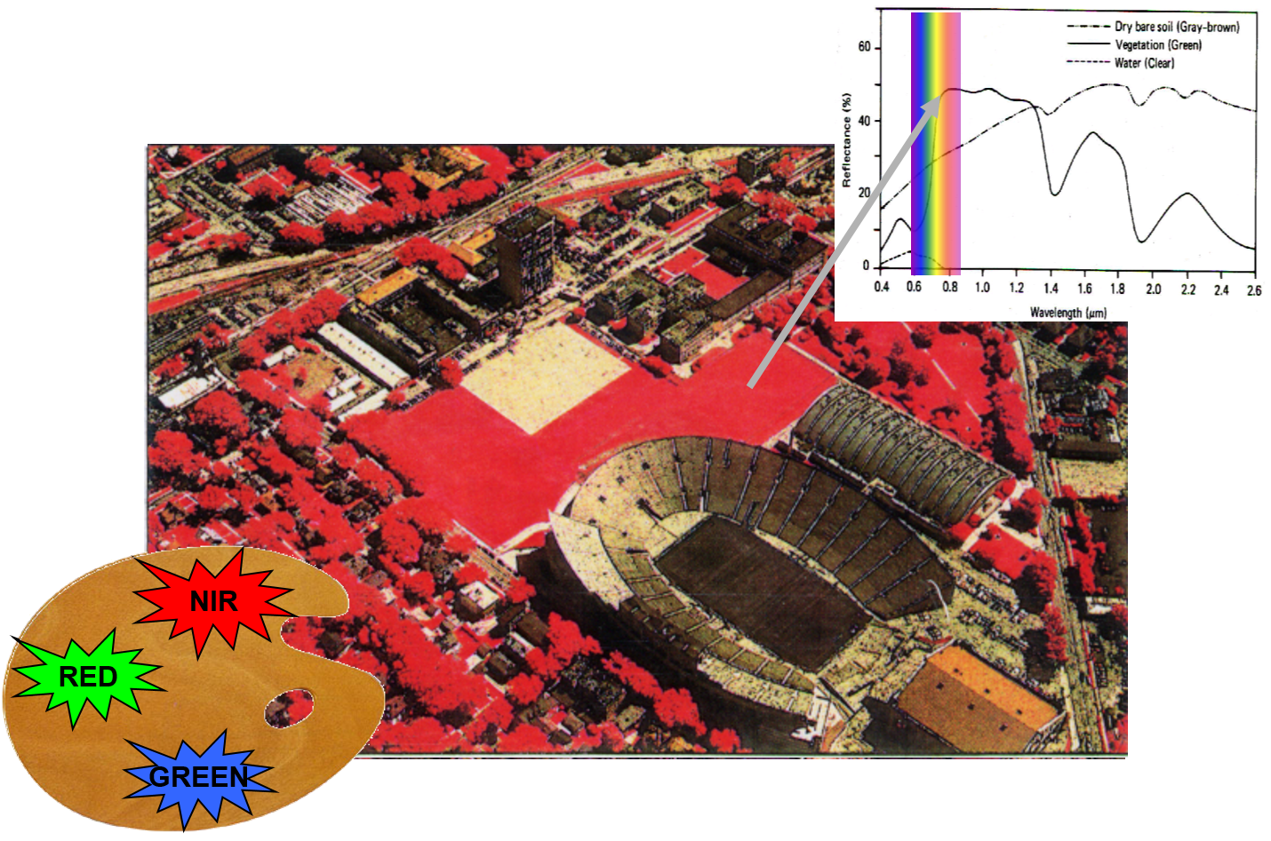
IR: False colour composite
Notes:
Here we put the amount of reflected EMW in the NIR length in the red colour.
The reflected amount of the red-wave in the green color and the reflected amount of green-wave light into the blue color.
This False color composite give us new insights into the surroundings.
One thing that must be noticed for example is that there is no red in the stadium. This meaning it does not reflect NIR. However, the grass surrounding the stadium does reflect NIR.
Why?
Only real healthy plats reflect NIR. Thus, the grass in the stadium is artificial grass. With this one can for example check who of your neighbors has fake grass.

Slide 21
Spectral signature
4
Notes:
Now that the concept of the data a satellite collects is cleared out, the reason to look at more then just RGB comes into play.
An important concept for this is spectral signature.

Slide 22
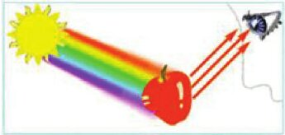
Interaction object-light
Abu Hassan, Yusof, Azmi, & Mazli, 2012
Notes:
Small repeating of the precious parts on how light is seen and acts.
M. F. Abu Hassan, Y. Yusof, M. A. Azmi, M. N. Mazli. (2012). Fuzzy Logic Based Intelligent Control of RGB Colour Classification System for Undergraduate Artificial Intelligence Laboratory. Proceedings of the World Congress on Engineering 2012 Vol II WCE 2012, July 4 - 6, 2012, London, U.K.

Slide 23
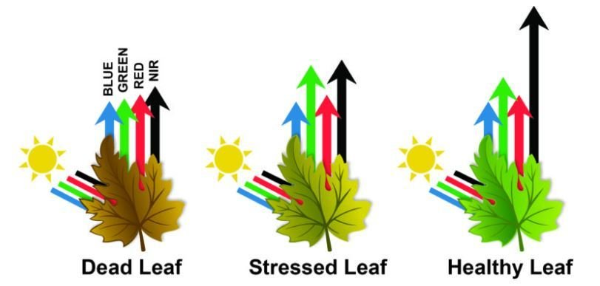

What can this reflection tell us?
Radiation can be absorbed by a target, transmitted through a target or reflected. The proportion of each depends on the wavelength and surface features.
Vecteezy, n.d.
Notes:
As mentioned, objects reflect a certain amount of EM-waves and the other ones are absorbed.
In the case of plants, we know a lot of green is reflected (with blue and red to make a certain green), but a healthy leave also reflects a lot of NIR.
So healthy or real plants reflect NIR and false or dead/ destressed plants not.
And this signature reflection is thus different for every object.
Vecteezy. (n.d.). Green leaf simple colored vector icon isolated on white square background: Simple flat outline cartoon vector icon drawing with natural leaf and botanical theme [Vector image]. Vecteezy. https://www.vecteezy.com/vector-art/24444471-green-leaf-simple-colored-vector-icon-isolated-on-white-square-background-simple-flat-outline-cartoon-vector-icon-drawing-with-natural-leaf-and-botanical-theme

Slide 24
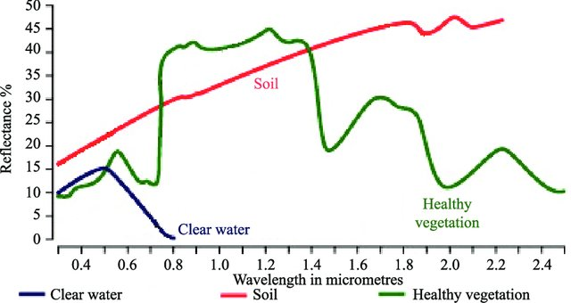
Spectral signature
Spectral reflectance curve
Spectral Reflectance is the amount of energy reflected from a surface at a specific wavelength.
Analysis of the spectral reflectance signatures
allows to distinguish different surface feature
or materials.
Spectral reflectance curve presents the
reflectance of objects as a function of wavelengths.
Kumar & Reshmidevi, 2019
Notes:
This leads us to the concept of a spectral signature of a spectral reflectance curve.
It shows the amount of energy reflected from the surface at specific wavelengths.
As this unique for different surfaces and materials one can use these to differentiate between them on images.
On the right a spectral signature is shown of some general materials.
One can see that water does only reflect in the shortest wavelengths.
Healthy vegetation reflects green en NIR
Kumar, D. N., & Reshmidevi, T. V. (2019). Reviews: Remote sensing applications in water resources. ResearchGate. https://www.researchgate.net/publication/330396782_Reviews_Remote_Sensing_Applications_in_Water_Resources

Slide 25
Spectral signature
There are even spectral library's, as each material has a specific signature.
However these are often in lab condition, but you can use the concept to make them for the context of your images: training
e.g. ECOSTRESS Spectral Library - Version 1.0
Notes:
Due to materials having a specific reflectance curve there are some very typical once that are easily recognizable (water, plants).
However there exist library's for checking what a material is.

Slide 26
Image properties
5
Notes:
As distinguished in the previous parts satellites produce images, but there are some properties one has to take into account.

Slide 27
Resolutions
5.1
Notes:
There are multiple types of image resolutions.

Slide 28
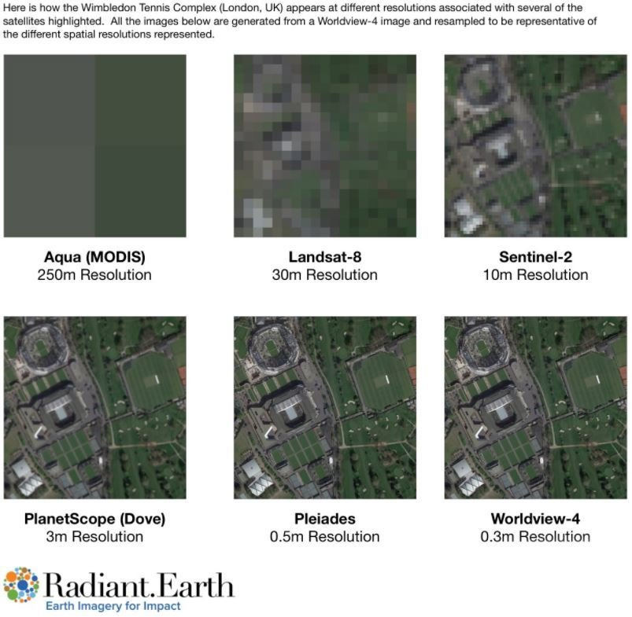
Spatial resolution
The size of the smallest area observed on the ground (ground resolution cell)
Importance:
Object is usually detectable if it is equal or larger than the pixel size.
The smaller objects could be still detectable as the average brightness of all objects within the pixel.
Notes:
The spatial resolution is the size of the smallest area that is covered in the image. Also refereed to as the size of the pixel covering the ground cell.
An object is often detected if it is the same size as the resolution, or larger; however, it can sometimes still be seen.
Bigger resolutions are not always better, sometimes it is so detailed that you do not see bigger patterns.
Also know that the higher quality images are not free.

Slide 29
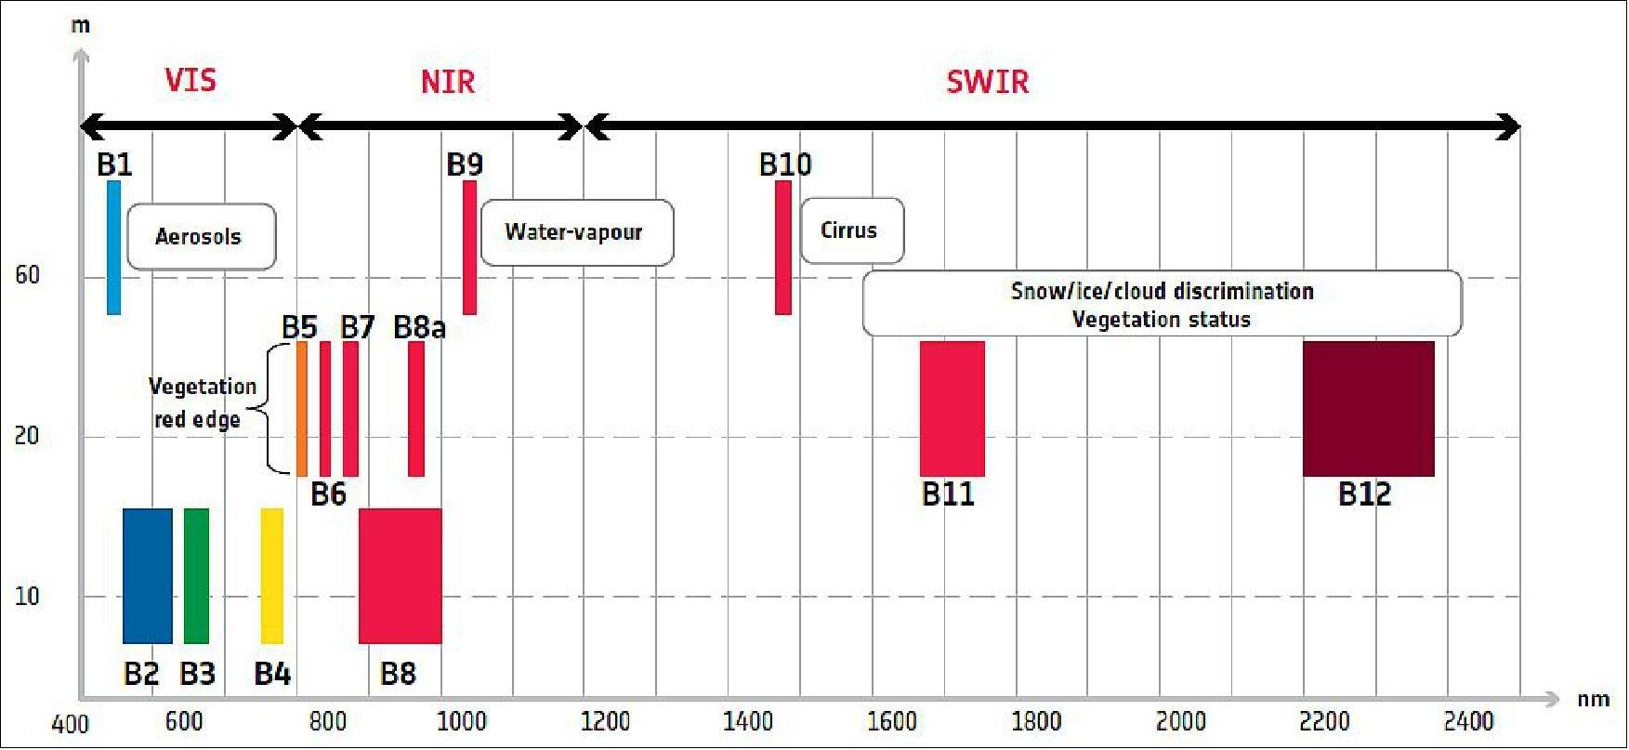
Spectral resolution
Refers to:
the spectral bandwidth
the number of bands.
The finer spectral resolution, the narrower the wavelength range for the particular band.
Notes:
The spectral revolution refers to the things in the EM-spectrum can detect.
It is 2 folded, on one hand the number of bands. On the other hand, how broad a band measures.
For the second part, a finer resulutions means that the band itself is smaller and measures less range. It might seem contractionary, but a smaller band means it measures not as general.

Slide 30
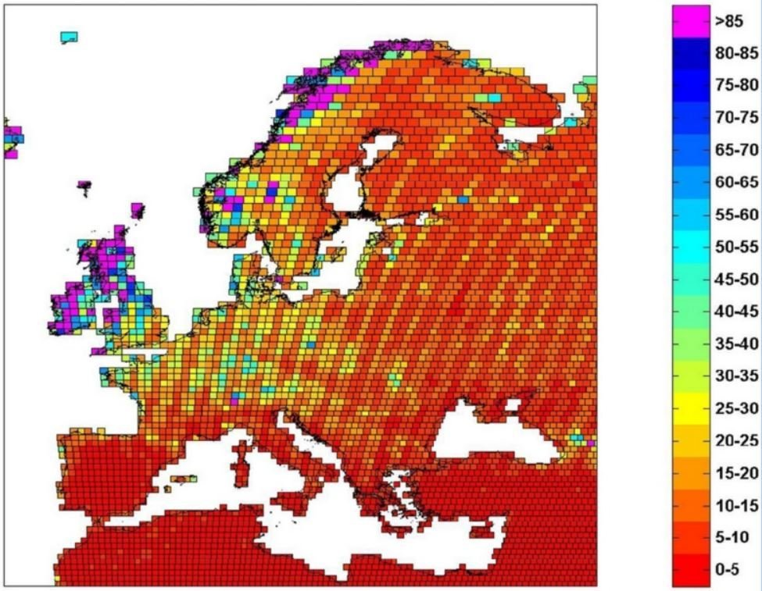
Temporal resolution
Frequency at which the same place is observed - revisit capability
Depends on the path of the satellite
Examples:
NOAA = 1 day
Landsat = 16 days
Sentinel-2 = 5 days
It is particularly important for change mapping.
Notes:
The temporal resolution is a resolution that has nothing to do with the intake differences of the satellite itself. But it has to do with the timing of detecting/ capturing images.
How long it takes for a satellite to retake an images of the same area. Often it is also referred to as revisit capability/ time.
This depends on the satellite and thus makes an impact on how often/ frequent change can be detected, so it determines the capability of change mapping of satellite images.

Slide 31
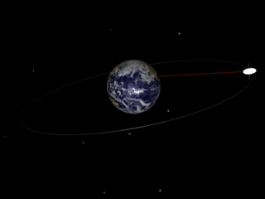
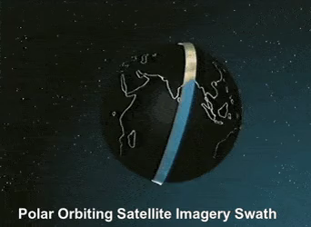
Temporal resolution
Satellite paths
Geostationary/ geosynchronous orbit Polar orbit
Notes:
The revisit time of a satellite is determined by how its path is going.
There are 2 types of satellites. The first one stays at the some point in space and is called a geostationary/ geosynchronous orbit. These satellites are often used for weather predictions as they monitor a certain region constantly.
The other type moves around earth always scanning another part of it, and lives in a polar orbit. For these keeping timing on when it revisits the same place is important.
Fayil:Geosynchronous orbit.gif – Wikipedia
geosynchronous orbits are often referred to as geostationary if they are roughly over the equator, but the terms are used somewhat interchangeably.
Whole-Globe Coverage with Polar Satellite : r/physicsgifs (reddit.com)

Slide 32
LiDAR
6

Slide 33
LiDAR
Li Light
D Detection
A And
R Ranging
Remote sensing method
Generates precise 3D shape with detailed characteristics of surface
Notes:
What is lidar?

Slide 34
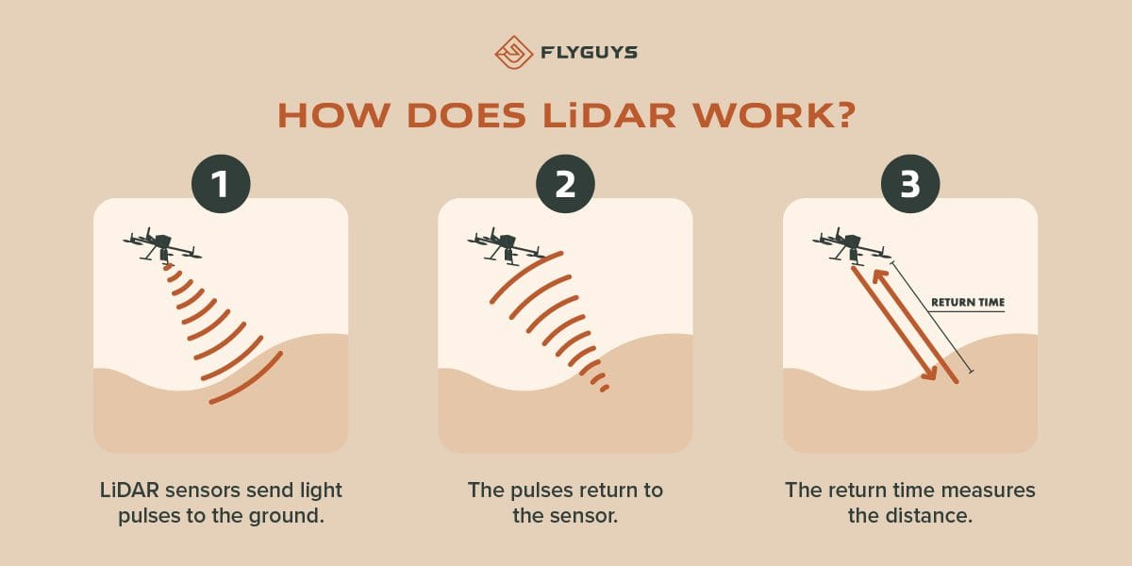
How it works?
Pulsed laser is sent out
The laser beam is reflected on the impermeable surface
The signal is returned
The time between return and outbound Is used to
Calculated distance.
GNNS is used to add a spatial reference to each point
Notes:
LiDAR vs RADAR: What’s the Difference? | FlyGuys

Slide 35
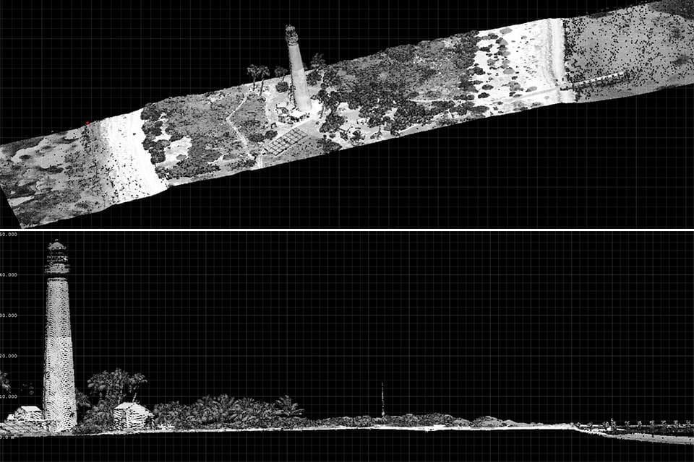
Pointcloud
Output of LiDAR scan
Format of output
One received reflected laser = point
All reflected points are in one file
3D referenced points
X, Y, Z coordinate for each point
Can be used as basis for other products
Sometimes includes optical information
or optical images draped over it
Notes:
Basis other products: historically they used it to remove all on top and build DSM’s.
However, over time the realization came that this ‘noise’ once always removed also contains lots of useful information.
What is lidar?

Slide 36
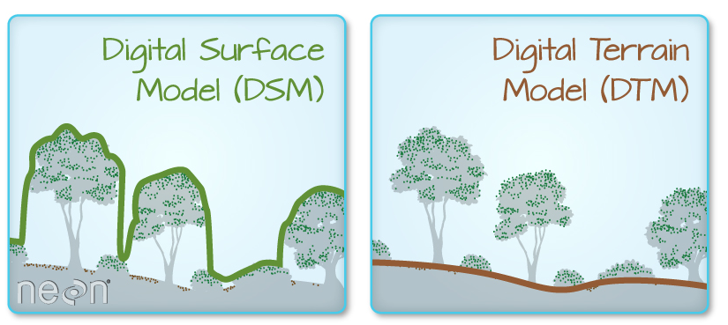

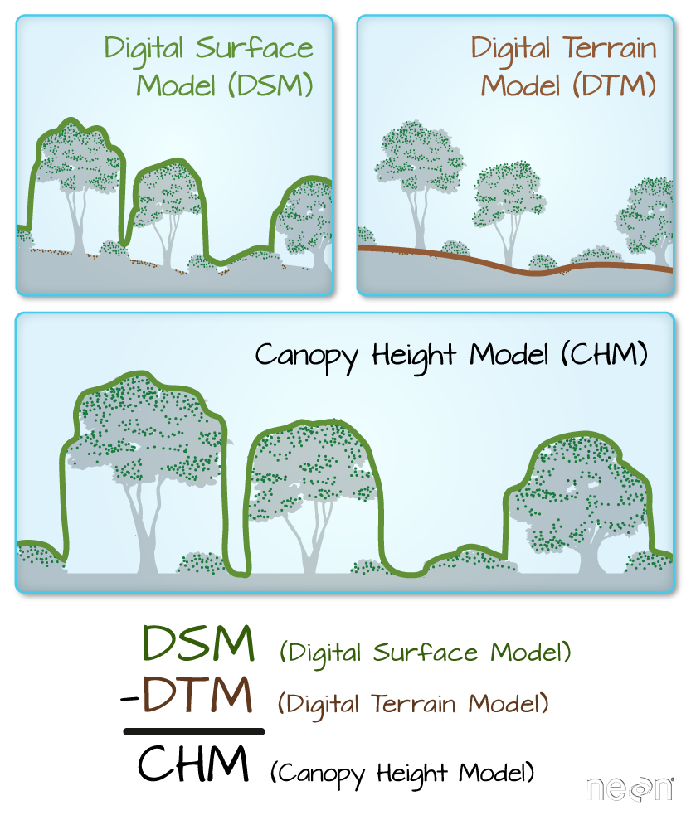
Extracted products
Notes:
What is a CHM, DSM and DTM? About Gridded, Raster LiDAR Data | NSF NEON | Open Data to Understand our Ecosystems

Slide 37
Satelitte data sources
7
Notes:
Information on data sources.

Slide 38
Level of pre-processing
Level 0
unprocessed instrument/payload data at full resolution
most raw format available
Level 1A
- reconstructed, unprocessed instrument data at full resolution, time-referenced
annotated with ancillary information including radiometric and geometric calibration coefficients and georeferencing parameters (e.g. platform ephemeris data) computed and appended
Level 1B
Level 1B data are Level 1A data that have had instrument/radiometric calibrations applied
Level 2
consist of derived (by the l2gen program) geophysical variables at the same resolution as the source Level 1 data
variables are grouped into a few product suites (e.g. OC [ocean color], SST, and SST4 for MODIS).
Level 3
- derived geophysical variables that have been aggregated/projected onto a well-defined spatial grid over a well-defined time period
Notes:
One other thing to know is that the satellite data most people work with is not the images directly made on the satellite itself.
The data is pre-processed. This is needed due to multiple reasons. But one of them is that raw data is not readable with image processing software.
So level 1A has this fist one already done. The differences can be read on the slide.
Often L2 is used as it has been fully calibrated to the instruments and corrected resolutions.

Slide 39
Some online viewers
EarthExplorer (usgs.gov)
https://eos.com/landviewer/
Sentinel Hub EO Browser (sentinel-hub.com)
Notes:
Here there are some online explores listed.

Slide 40
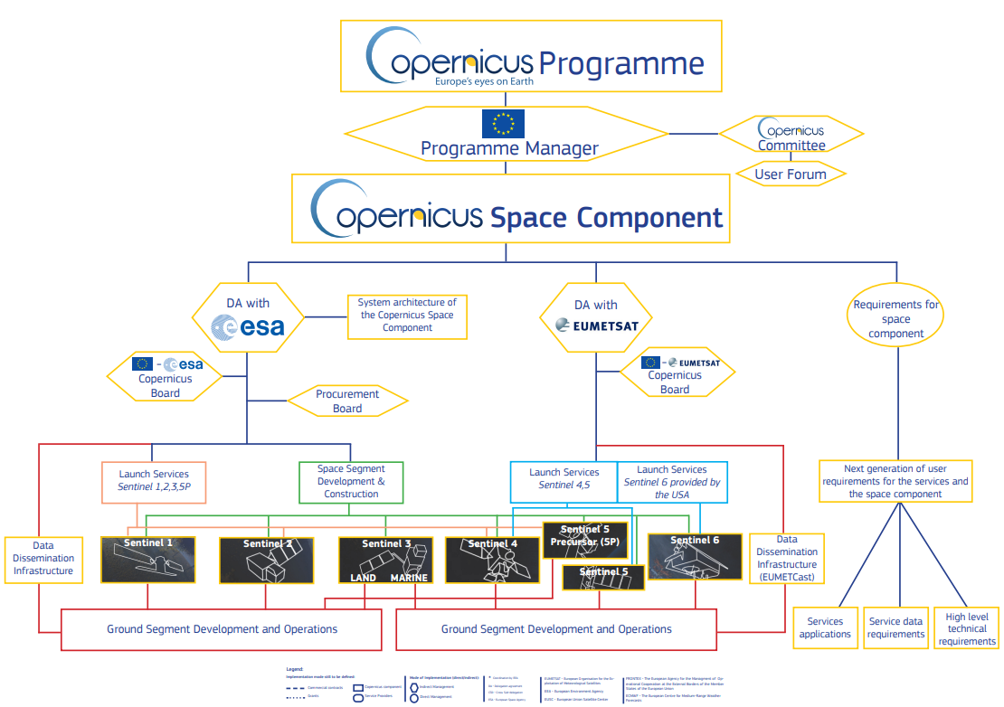
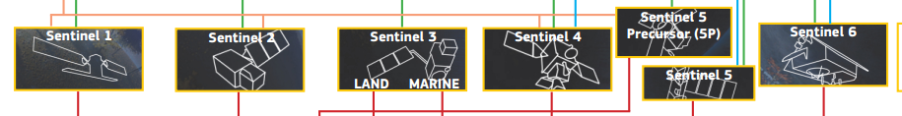
Copernicus
Earth observation component of the European Union’s Space programme
looking at our planet and its environment to benefit all European citizens
offers information services that draw from satellite Earth Observation and in-situ (non-space) data
Space component:
Notes:
Copernicus is the European satellite part of the space programme, focusing on EO.
It is driven from the environmental point.
There are multiple sentinel satellites, each with their own function.

Slide 41
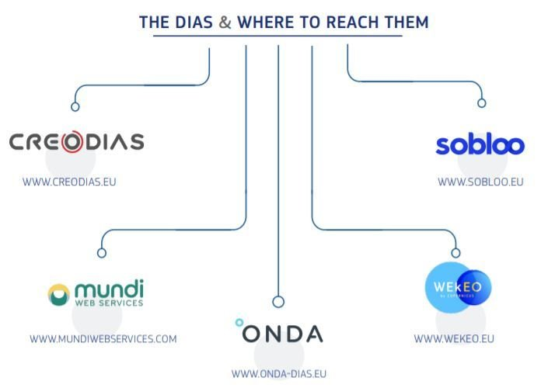
DIAS
To facilitate and standardise access to data, the European Commission has funded the deployment of five cloud-based platforms called DIAS providing centralised access to Copernicus data and information, as well as to processing tools.
All DIAS platforms provide access to Copernicus Sentinel data, as well as to the information products from Copernicus’ six operational services, together with cloud-based tools (open source and/or on a pay-per-use basis).

Slide 42
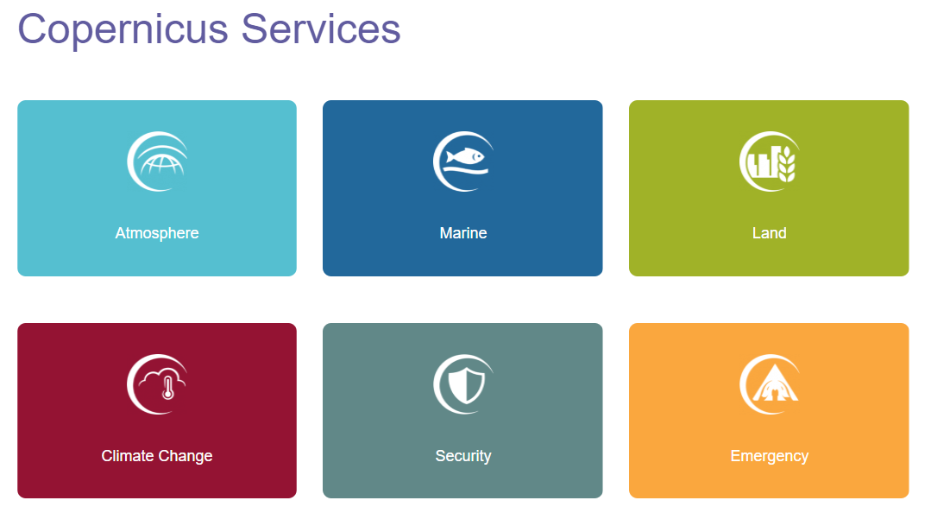
Copernicus services
Satellite data → value added information
Grouped by theme:
Notes:
Copernicus also has services where they add extra information, can be some analysis or other information.
These are grouped by theme and can be found as the ‘Copernicus Services’

Slide 43
Explore
https://browser.dataspace.copernicus.eu/
Copernicus Services | Copernicus (LAND)
CLMS portfolio — Copernicus Land Monitoring Service
Notes:
Explore the three links to RS data

Slide 44
Source
This course is based on EO4GEO content:
Hościło, A., Tramutoli, V., Capece, N., & Satriano, V. (n.d.). Introductory exercise course to remote sensing. EO4GEO. http://www.eo4geo.eu/training/introductory-exercise-course-to-remote-sensing/

